Slide 1
Encompass Government Forms

Slide 2
Encompass Government Screens
FHA :
HUD 1003 Addendum
FHA Management

Slide 3
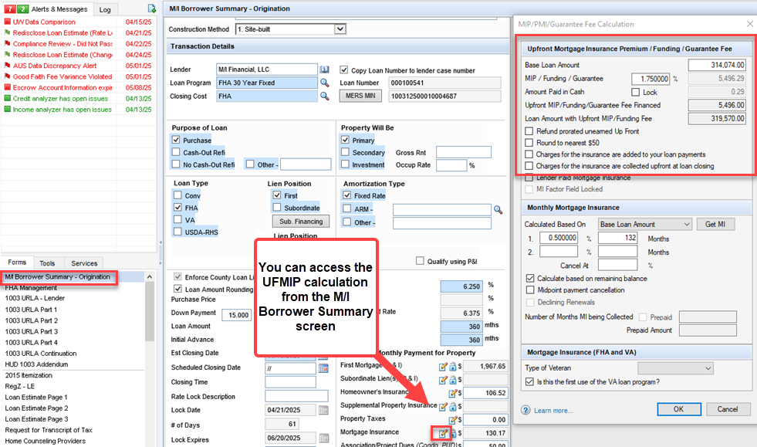
FHA – M/I Borrower Summary

Slide 4
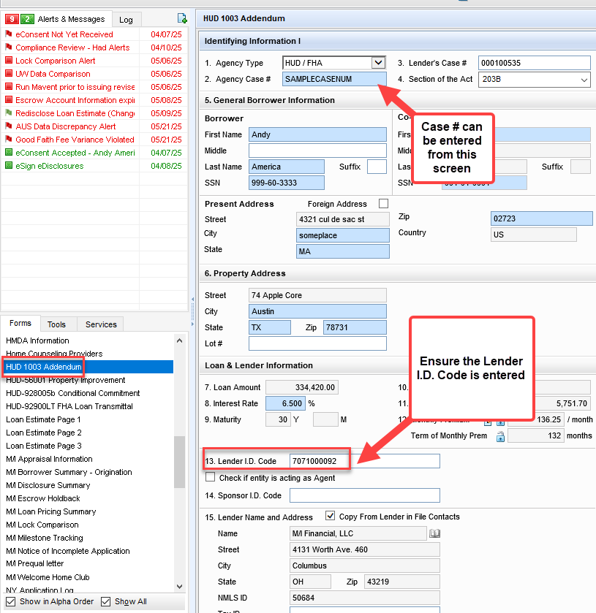
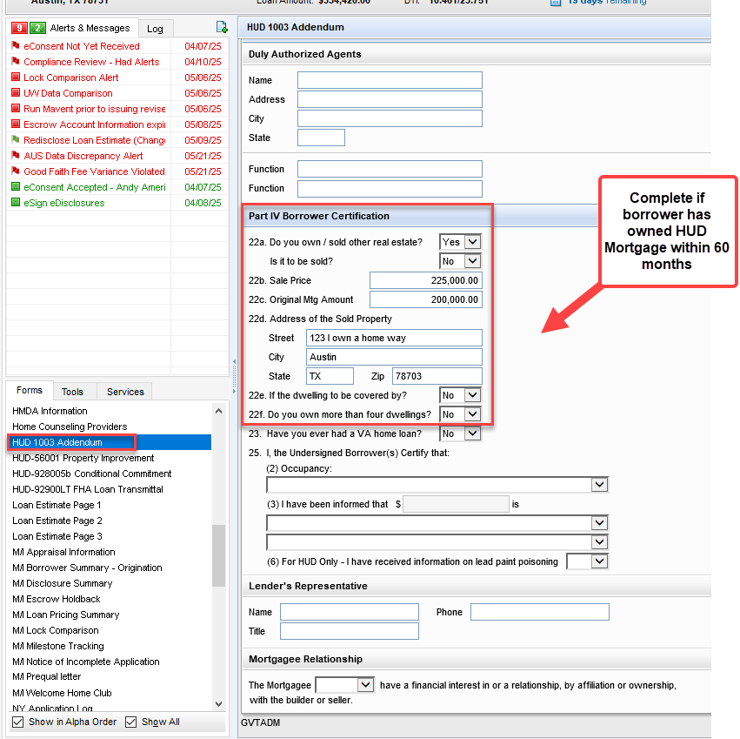
FHA Screens – HUD 1003 Addendum

Slide 5
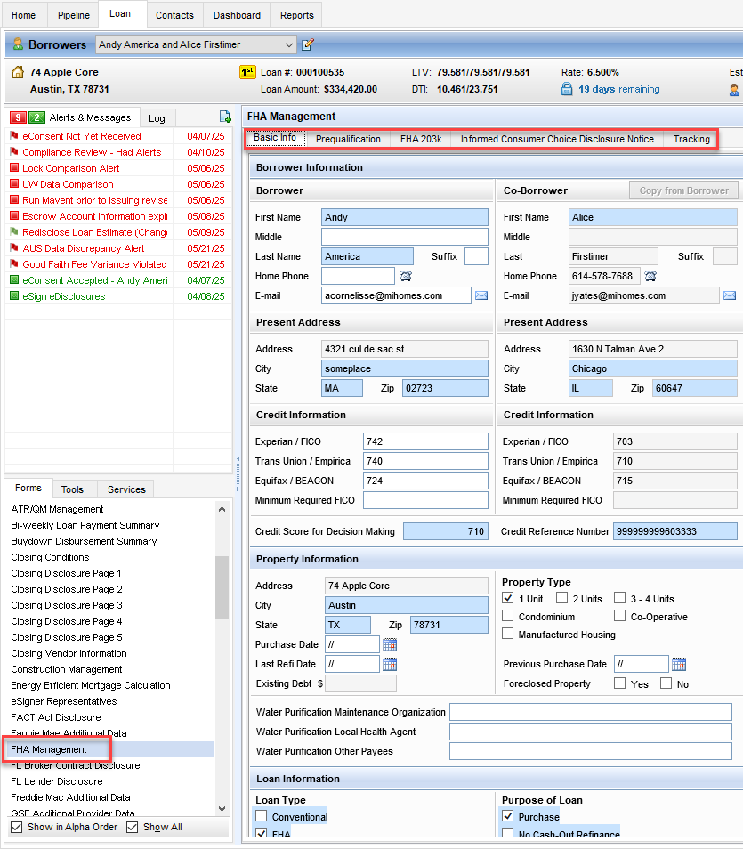
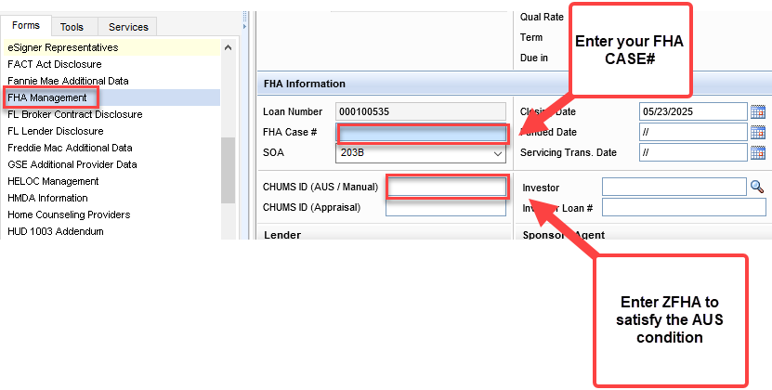
FHA Screens – FHA Management

Slide 6
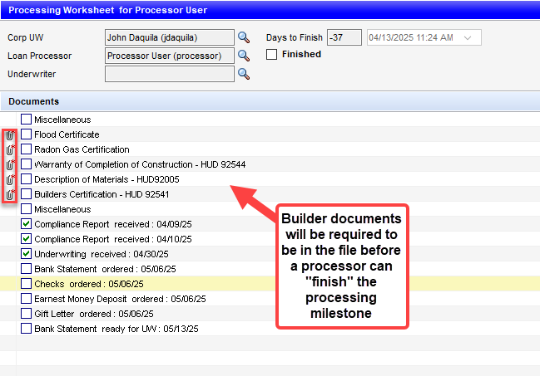
FHA Screens - Milestone
There are Document placeholders for the VA/FHA property documents.
These need to be added to the eFolder prior to completion of the Processing milestone.

Slide 7
Encompass Government Screens
VA:
VA Management
VA 26-6393 Loan Analysis
VA 26-1820 Loan Disbursement

Slide 8
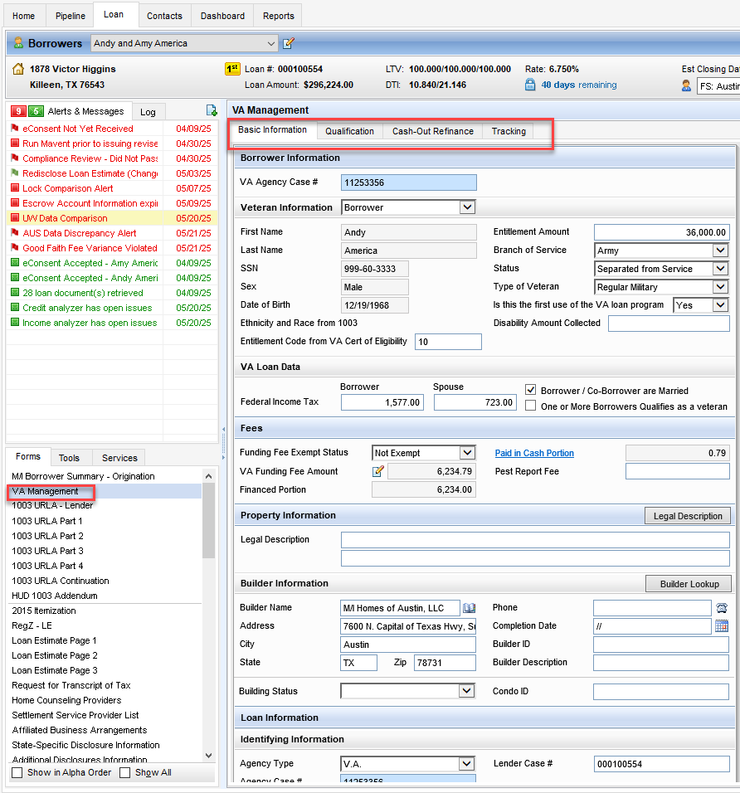
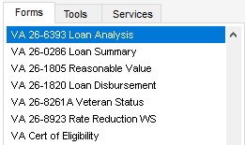
VA Screens: Overview

Slide 9
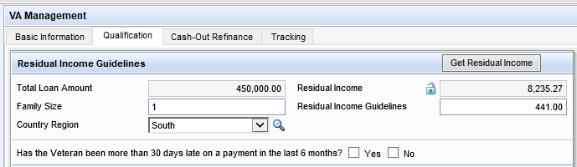
VA – Helpful Hints VA Management Screen/Qualifications Tab
Review and confirm the following:
Family Size, Country Region, and Residual Income Guidelines are correct.

Slide 10
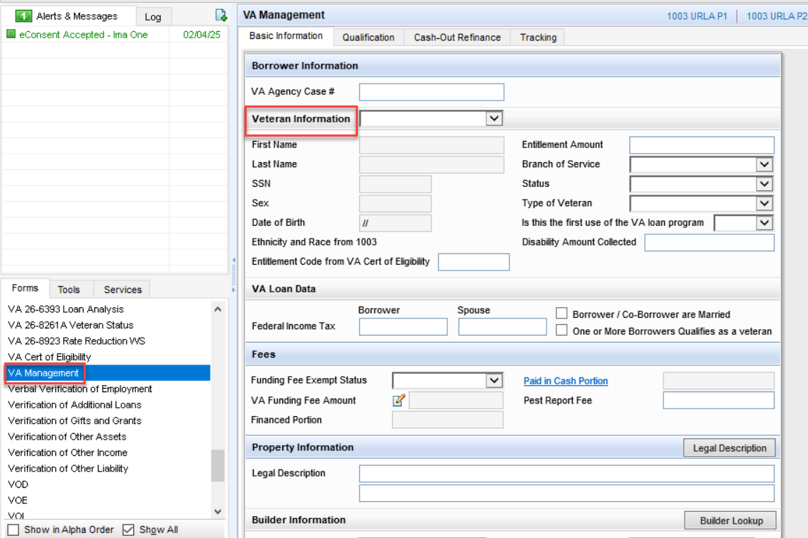
VA Management: Basic Information

Slide 11
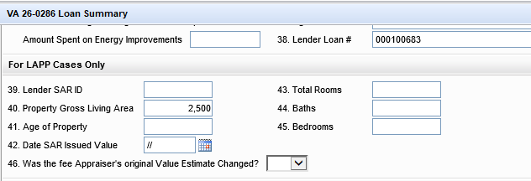
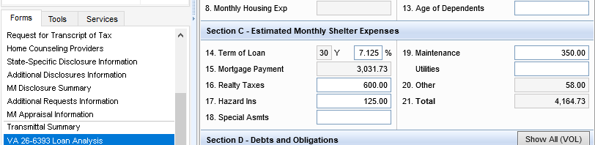
VA – 26-0286 Loan Summary Gross Living Area and Maintenance
The appraisal review team will enter the property gross living area on line 40.
Confirm this is entered so that on Section C –Line 19 Maintenance is entered and correct in the VA Loan Analysis

Slide 12
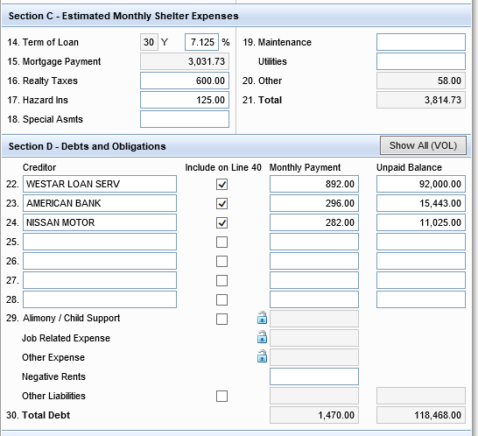
VA – Helpful Hints – VA Loan Analysis
In VA Loan Analysis:
Section D – Debts and Obligations:
All liabilities being counted MUST be checked. If there is a debt that someone else is responsible for, leave it unchecked.
If you have a ton of liabilities, they will not all show up. You will need to click on #29, Other Liabilities so that it will include them in the ratios.
**IMPORTANT** If one of the liabilities that are in the “other liabilities” section and need to be excluded: Click on the Show All (VOL), highlight that liability and use the up arrow to move it towards the top so that it is one of the 7 that show up on the Debts and Obligations and uncheck it there.
If there are childcare expenses, it needs to be included in section 29 under Job Related Expense.

Slide 13
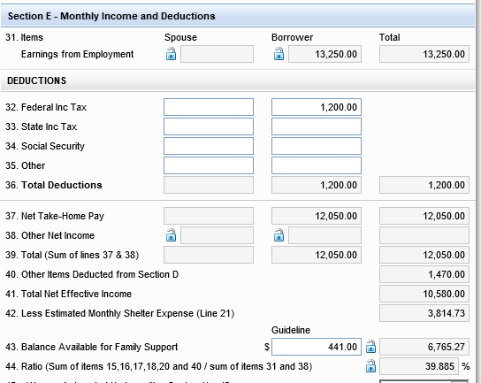
VA – Helpful Hints – VA Loan Analysis
You will also notice the Guideline for family support (line 43) flows here from the VA Management screen.
Your ratio on line 44 should always match your DU findings.

Slide 14
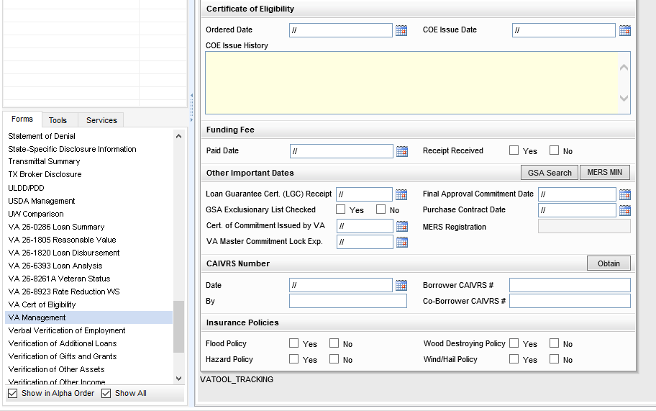
VA Management: CAIVRS
Make sure you are completing the following areas using information from the COE:
Entitlement code
Married to borrower?
Did they previously have a VA loan?
Exempt from funding fee?
Branch of Service
Military Status

Slide 15
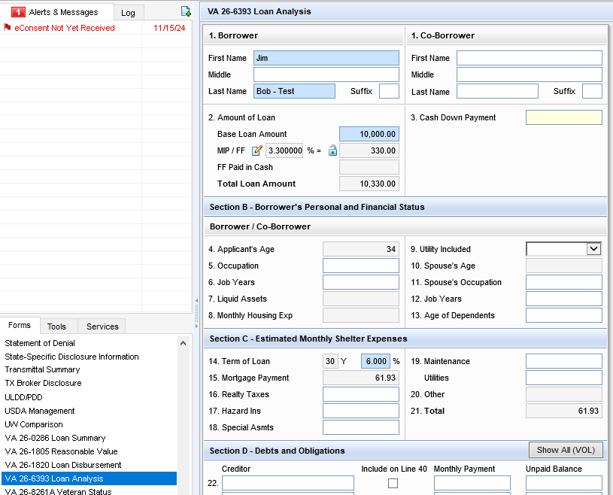
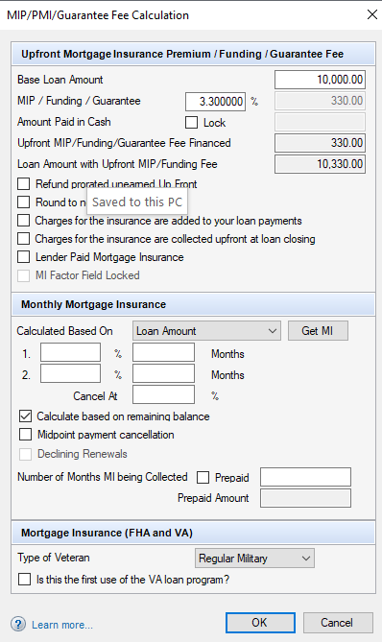
VA 26-6393 Loan Analysis: FF

Slide 16
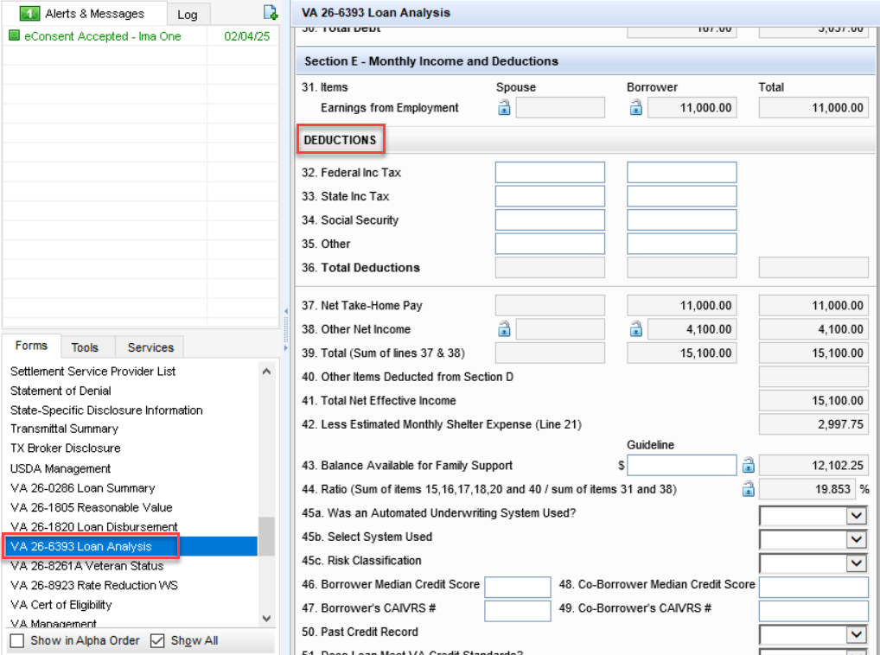
VA 26-6393 Loan Analysis: Deductions
Just like you do today, you will need to pull information from paycheck city in order to complete the borrowers deductions.

Slide 17
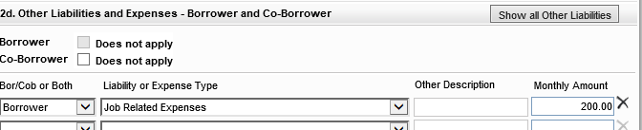
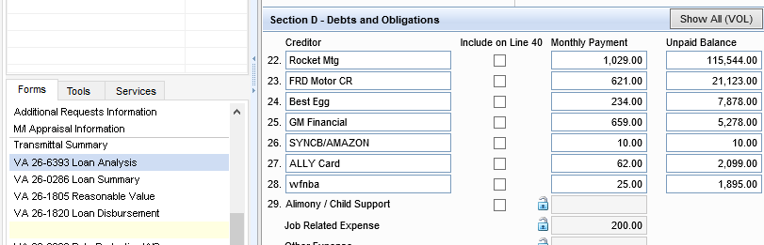
VA 26-6393 Loan Analysis: Childcare
If childcare expenses are discovered during the application process, you will need to add the amount to other liability/job related expenses.

Slide 18
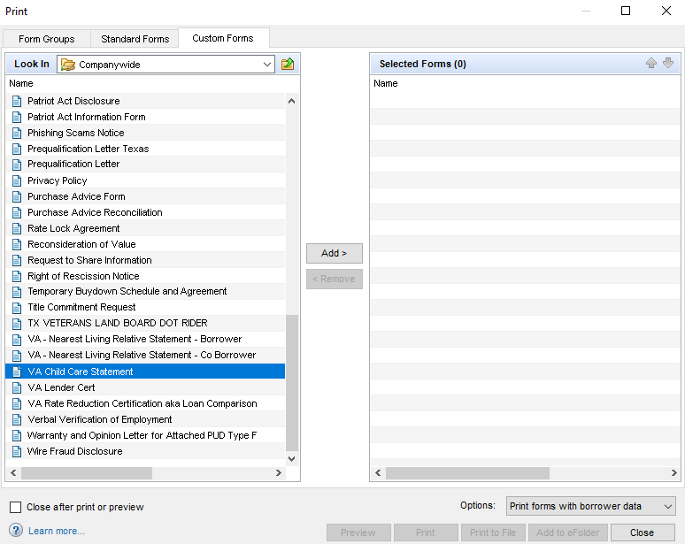
VA 26-6393 Loan Analysis: Childcare
When there is childcare expenses, go into:
Print, Custom Forms, VA Child Care Statement, and add the form to Selected Forms.

Slide 19
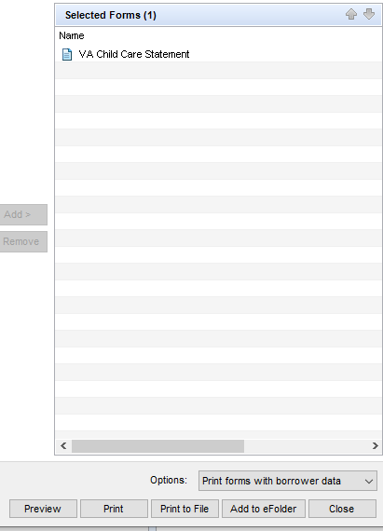
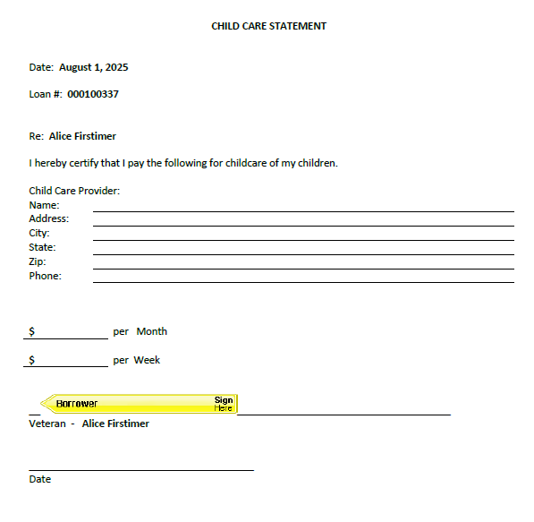
VA 26-6393 Loan Analysis: Childcare
You can preview and add to the eFolder to send to the borrower via ECC.

Slide 20
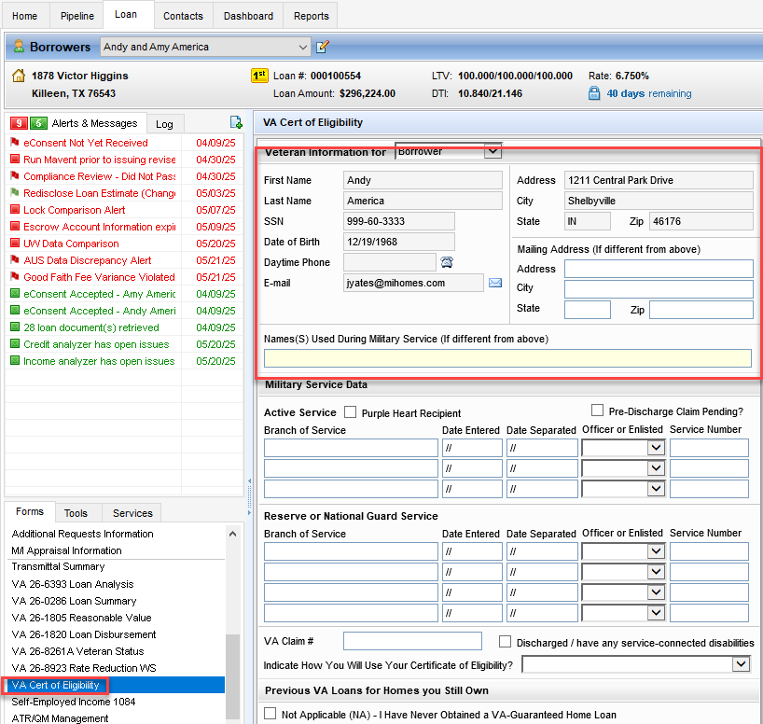
VA Cert of Eligibility

Slide 21
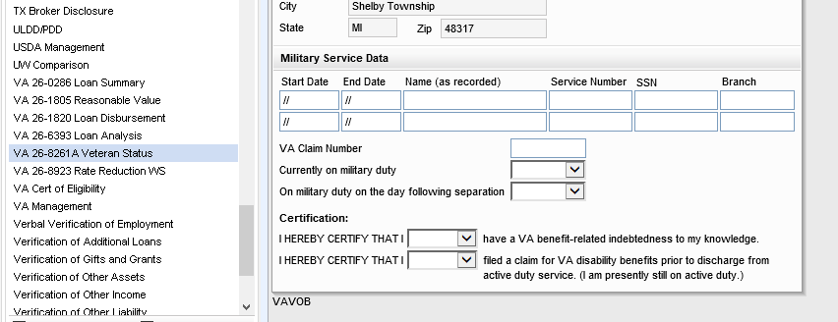
VA 26-8261A Veteran Status
Military Service Data – Needs to be confirmed in encompass. It is required to be completed for all Veterans. If on Active Service = only include any activation for duty (inclusive of Reserve and National Guard). Include any periods of Active Duty of Training or Active Guard Duty.

Slide 22
VA Screens - Milestone
There are Document placeholders for the VA/FHA property documents.
These need to be added to the eFolder prior to completion of the Processing milestone.

Slide 23
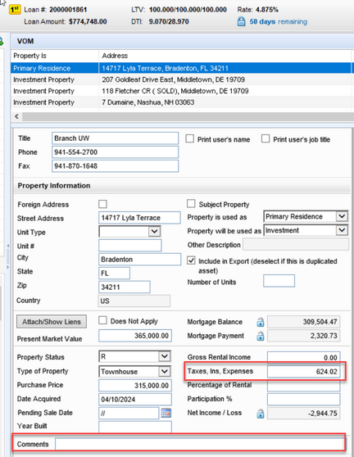
Real Estate Owned Section
When borrower’s have additional properties owned, make sure that you are opening the VOM section and selecting the property you need to edit.
HOA dues for each property need to be added to the VOM Taxes, Ins, Expenses field. Use the comments section to breakdown the monthly amount so Branch Underwriting so you can reference what that total included.
Example: if $624.02 is HOI and Taxes then add the HOA dues monthly and breakout your comments like (HOI = $XX , Taxes = $XXX, HOA dues = $XXX).

Slide 24
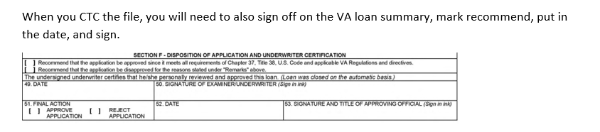
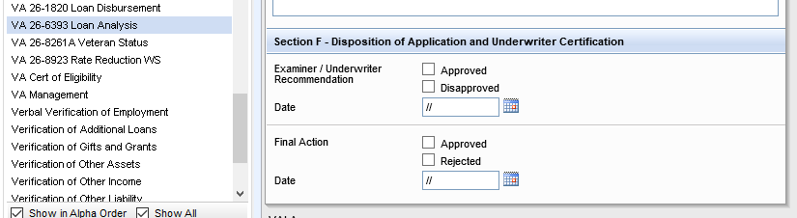
VA Loan Sign Off

Slide 25
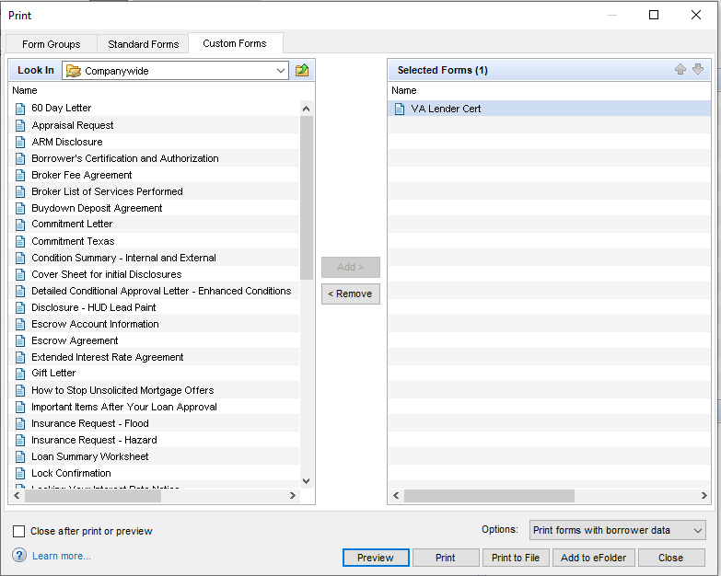
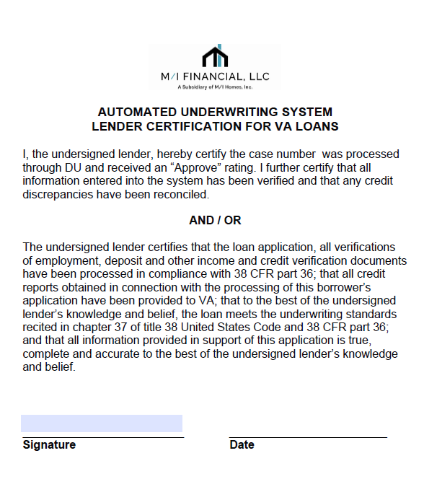
VA Loan Sign Off: Lender Cert
The Automated Underwriting Lender Certification will still need to be completed by the Branch Underwriter prior to CTC. This can be found by pressing the printer icon, custom forms, and selecting VA Lender Cert.

Slide 26
Thank you

Slide 27





